Slide 1

Feedback Collection and Rating System for Stores
ACMS Group 7
Mentor - Mr. Gourav Sharma
Ankita Rai
Nipun Soni
Shikha
Shruti Kalra Shuchita Dobhal
Indira Gandhi Delhi Technical University for Women

Slide 2
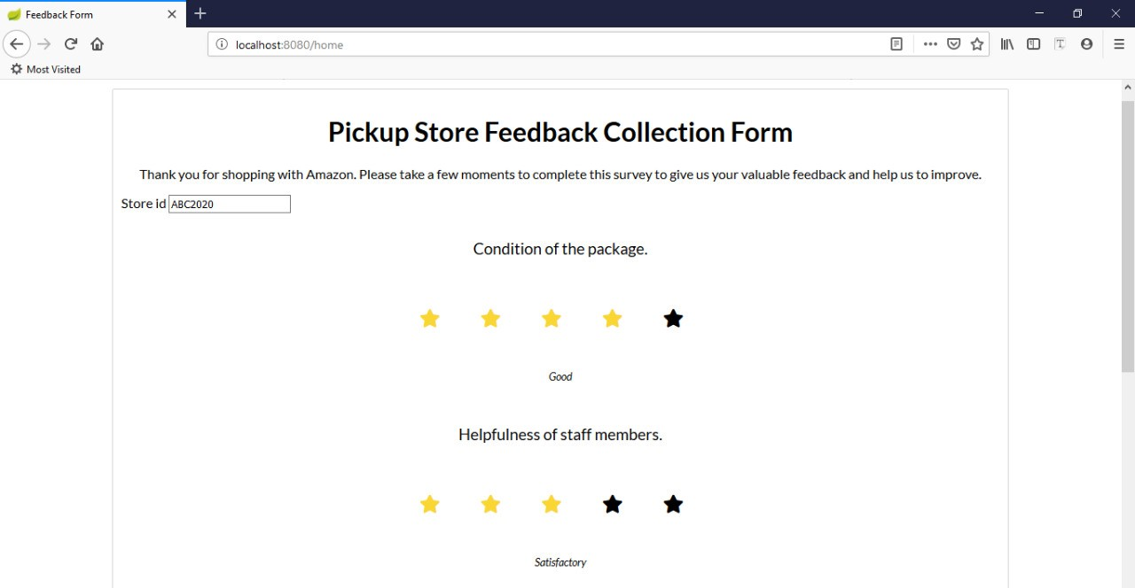
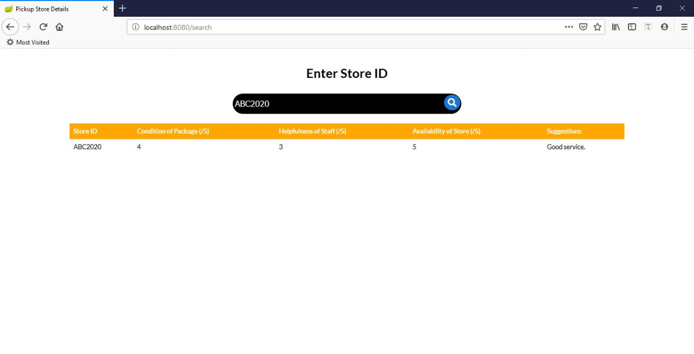
Problem Statement
Currently, Amazon customers can opt for their nearby store shop as delivery address where store owners play a critical role in package management.
Our product focuses on enhancing customer service by taking feedback from them and setting up a reward system for the store owners.

Slide 3
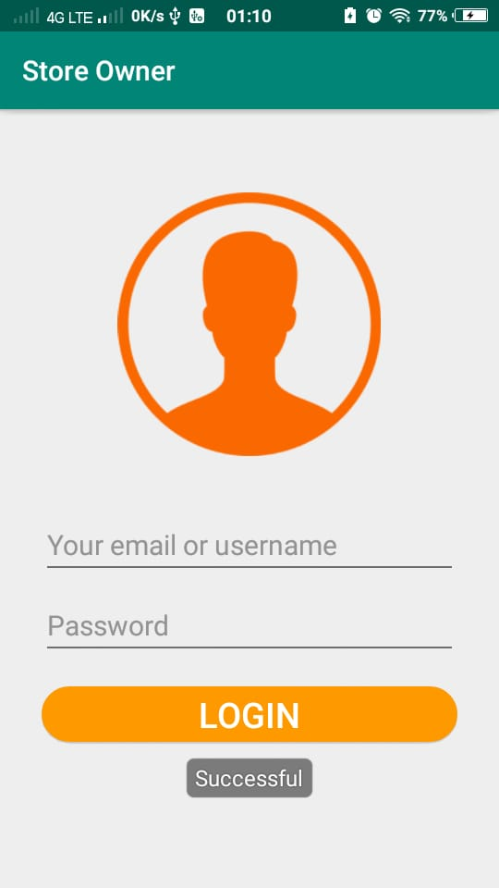
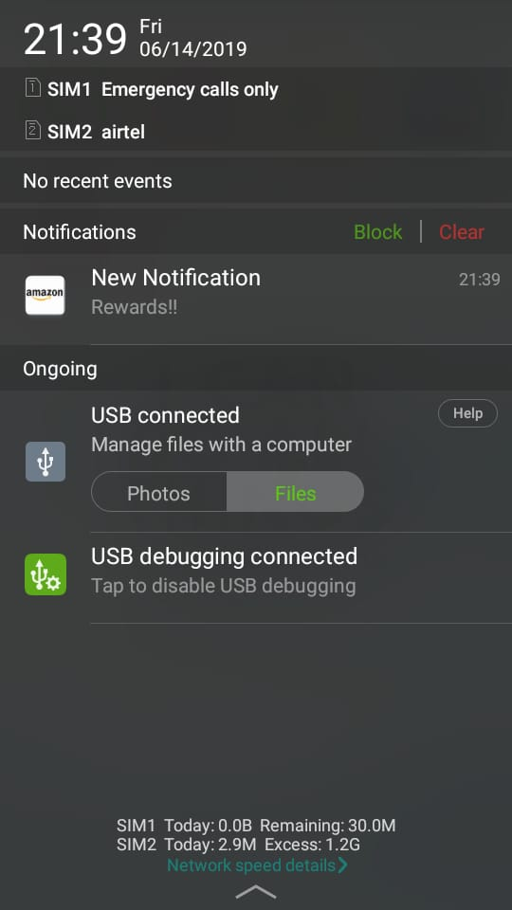
Technical Solutions
Scope
Fetching data from the database to display it on the page done by implementing thymeleaf format in both frontend and backend.
Customer feedback taken from the customer is stored in MongoDB
An online feedback questionnaire having three questions for rating the customer experience is provided to all the customers.
A store performance evaluation system evaluates the performance of a store on the basis of the following traits:
average customer feedback
no. of successful packages delivered
no. of failed deliveries
successful pickups
pickup failures
lost packages.
A reward notification is sent to the store owner’s mobile app whose performance matches or exceeds the Amazon criteria.

Slide 4
Product
Store Rating Search
Backend
Mobile App
Frontend
Customer Feedback
MongoDB
Reward Notification
Other Applications

Slide 5
PRODUCT DEMO

Slide 6
Reusability
Trade Offs
Applicable on other Supply chain participants.
Database table & APIs are designed to be expandable to incorporate future use cases.
Mock files used in the product can be easily replaced or modified while the controller and the classes remain the same.
We used MongoDB instead of DynamoDB due to issues in setting up DynamoDB.
Firebase was used instead of MongoDB for the mobile app since Firebase provides push notification system which sends notifications only to the specified users.

Slide 7
Scale
Future work
Link mobile app to MongoDB and send reward notification after processing feedback data collected for a store
Send email to customer after pickup
Validate store id entered during search
Add the review given by a customer to a store to the customer database
Revert back to customers on actions taken based on feedback
Use of ML to suggest nearest store to customer based on collected ratings
Display average rating of selected store to the customer
MongoDB can handle upto 3TB of data per node.
The database chosen and the schema and APIs used provide fast access to the data.
Benefits
Increase active participation from the store owners through reward system and constructive feedback.
Help in improving package pickup experience of the customers and hence enhance the quality of services provided by the company.

Slide 8


